Slide 1
Feminist Geography
Geog 360 Human Geography, Dr. Jocoy CSULB

Slide 2
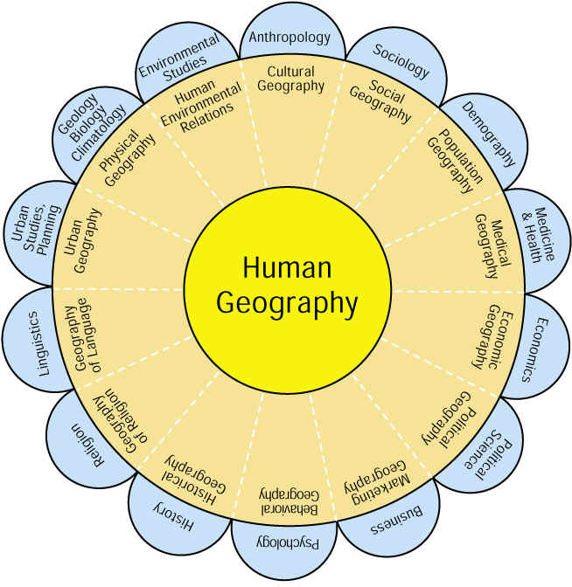
4. Subareas of Human Geography

Slide 3
AAG specialty groups
http://www.aag.org/cs/membership/specialty_groups

Slide 4
Learning Objectives
Summarize what is meant by “geographies of identity”
Distinguish among various types of feminisms & key feminist concepts
Distinguish between sex & gender
Define feminist geography
Identify feminist geographic concepts in Maria Elisa Christie’s article Kitchenspace, Fiestas and Cultural Reproduction in Mexican House-Lot Gardens
Identify research methods use in Christie’s study

Slide 5
1. Geographies of Identity
Def. - spatial expression of social relationships related to individual and collective constructions of self
Ex: race, ethnicity, gender, sexuality
Related terms from cultural geography: Spatial inclusion and exclusion – in-place/out-of-place – who is deemed to belong in a place and who is excluded from it.
Identity also creates social spaces.

Slide 6
1. Principles that apply to identity
Human identity is dynamic, multidimensional, contingent
Identity is contingent – our sense of who we are depends on where we are geographically and temporally, who we are with, and what we are doing.
Scale matters – individual, regional, national scale.
Not easily categorized. Efforts to classify people into groups tend to exaggerate differences among people, especially visible difference.
Identity is a social construction both individual and collective– an idea or phenomenon that does not exist in nature but is created and given meaning by people.
May be based on some biological differences but the meaning of those biological differences and how we act towards them is created by humans and social interaction.
We learn identity through socialization.

Slide 7
2. Feminism(s)
A political movement
A research approach that considers gender dynamics and the role of patriarchy in shaping knowledge.
A belief that the social world advantages some types of people and disadvantages others.
Not male-bashing
Notes:
Think of someone in popular culture that you consider to be a feminist and state why?
Think of a historical figure that you consider to be feminist and state why?
Can men be feminist? http://www.broadagenda.com.au/home/meet-the-male-feminist-professor-jonathan-crowe/

Slide 8
2. Commonalities in Feminisms
Believes in equal opportunity for men and women. Fights discrimination against women.
Views gender or racial groups as social positions (ex. Men as a social position rather than speaking of males as having essential traits)
Addresses individual & institutional views about gender
Individual views – e.g. girls can’t do math; women can’t be sports anchors
Institutional views – e.g. Prior to Title IX in 1970s, females were not considered good at sports so funding in schools was not equally available for female athletics

Slide 9
2. Different kinds of feminisms
Examples:
Anti-pornography
Reproductive rights
Equal work for equal pay

Slide 10
2. Patriarchy & Sexism
Patriarchy - social order or system based on the rule of men over women and a privileging of masculine traits, identities & practices over feminine ones.
Sexism – application of patriarchy in form of social domination of women and actions that subordinate women to men by defining women as biologically and/or socially inferior
Sexism - prejudice or discrimination based on sex or gender, especially against women and girls (Merriam-Webster’s Dictionary)

Slide 11
2. Feminist epistemology
Epistemology – system of thought through which questions of truth, authority, what counts for knowledge, and how one comes to know are addressed.
Patriarchal values shape the content and structure of knowledge and marginalize women’s lives and experiences.
Privileges white male bias or perspective
Rejects separation of researcher from subject being researched
Advocates researcher identifying as a gendered/racialized being

Slide 12
2. Intersectionality
Newest thinking in studying identity & systems of power
An approach for understanding identity and systems of power that looks at the complex intersections of identities (gender, race, class, sexuality, national origin) and marginalization or privilege occurring along those multiple axes
Recognizes that lived experiences don’t separate neatly along those axes
e.g. influence of gender on race, sexuality on gender, class on race, etc

Slide 13
Intersectionality
the complex, cumulative way in which the effects of multiple forms of discrimination (such as racism, sexism, and classism) combine, overlap, or intersect especially in the experiences of marginalized individuals or groups
Merriam-Webster’s Dictionary
https://www.merriam-webster.com/dictionary/intersectionality

Slide 14
3. Sex vs. Gender
Sex – male & female chromosomes
Binary idea, but really not exclusive
XX or XY but some individuals have an extra X or Y such as XXY or XYY or only one XO
Gender – masculine or feminine – the culture or social characteristics society associates with being female or male
Gender roles – social expectations, responsibilities or rights associated with femininity and masculinity.
Transgendered persons – do not identify with the gender assigned to them.

Slide 15
4. Feminist Geography
draws on feminist politics and theories to explore the spatial expression of gender relations and the mutual shaping of gender and space/place.
Gendered places – locations with gendered meanings
Gendered spaces – arrangements created with gender in mind & the way gender affects use of spaces.

Slide 16
Feminist approaches to subareas of human geography
Feminist cultural geography - explains importance of gender in establishing meaning of places.
E.g. Mexican house-lot garden
Feminist economic geography - explains how considering gender informs our understanding of the spatial expression of work, labor, employment and globalization.
E.g. occupational sex segregation; gendered view of home/workspace divide

Slide 17
5. Feminist Geographic Concepts in Christie’s article
Research question: What role do women play in nature-society relations through kitchenspace?
How is this research feminist?
Examines women’s experiences, gender roles in Mexican society in case studies in three communities
Socialization of girls to gender roles – gendered knowledge transfer
How is it about geography and gender?
Explores the gendered space, gendered knowledge, and narratives of cultural identity in kitchens & house-lot gardens (p. 371)
Examines women’s relationship to spaces (home & neighborhood) and nature. (p. 372)

Slide 18
Findings: What role do women play in nature-society relations through kitchenspace?
Gendered spaces in the landscape & adaptation to change
Gardens, kitchens, & yards – in contrast to cash-crops, industrial ag.
Illustrates gendered and spatial division of labor
Gendered space for food preparation
Community, semi-public space during fiestas
Women’s knowledge about natural environment
Food – both cultural beliefs and links to natural systems
Food narratives reflecting culture and identity
Food, fiestas - links to sense of place
Gendered knowledge- family relations transfer of gender roles; social obligations and moral values including service to community

Slide 19
6. Methods for Christie’s research
Three qualitative methodologies
Participant observation
In private kitchens of women in three communities
In semi-public space of house-lot gardens
Helped with their work
Ethnographic interviews
Asked questions of women while working
Listen to what they said while working
Participatory mapping
Sketches of kitchenspaces
Data: rich descriptions of observations, quotations, photos, and drawings

Slide 20
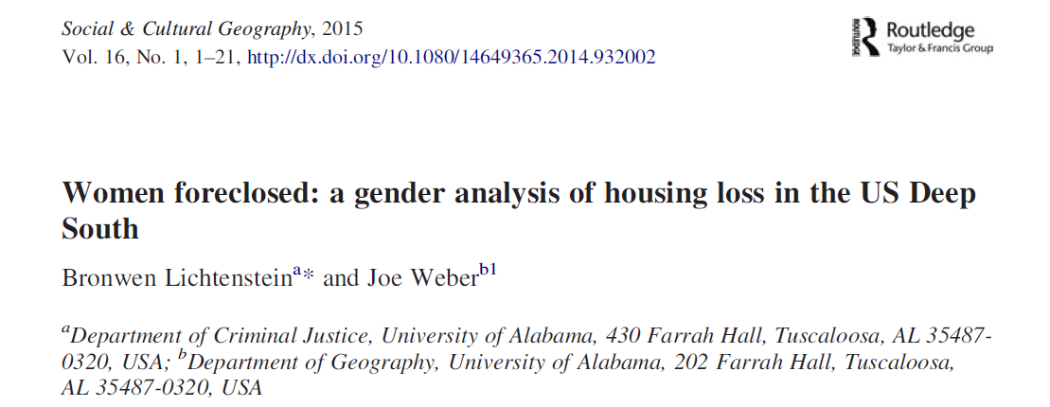
Critical Review Article 3
Lichtenstein, B. & Weber, J. (2015) Women Foreclosed: A gender
analysis of housing loss in the US Deep South, Social &
Cultural Geography 16(1): 1-21.

Slide 21
Key economic concepts in article
Mortgage
https://www.youtube.com/watch?v=GPOv72Awo68&list=PL1oDmcs0xTD-dJN1PL2N1urX0EKupBJCQ&index=14&t=32s
Foreclosure
https://www.youtube.com/watch?v=0cZyjoK9Eug
Housing bubble – rapid price increases in housing driven by irrational decisions
Subprime loan rate
https://www.youtube.com/watch?v=t70Mjl174_U
Predatory lending practices
Adjustable interest rates – go up over time

Slide 22
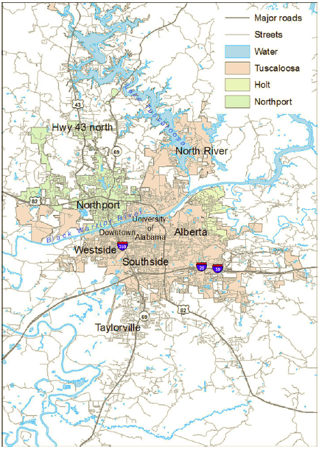
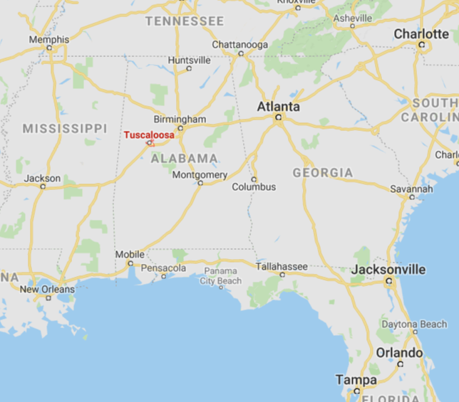

Slide 23
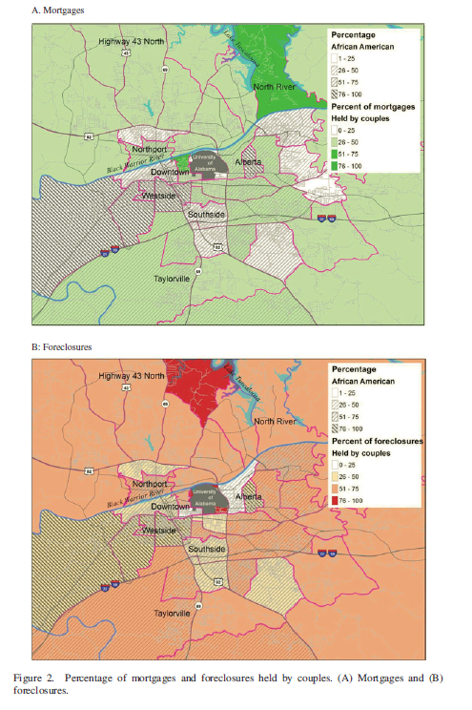
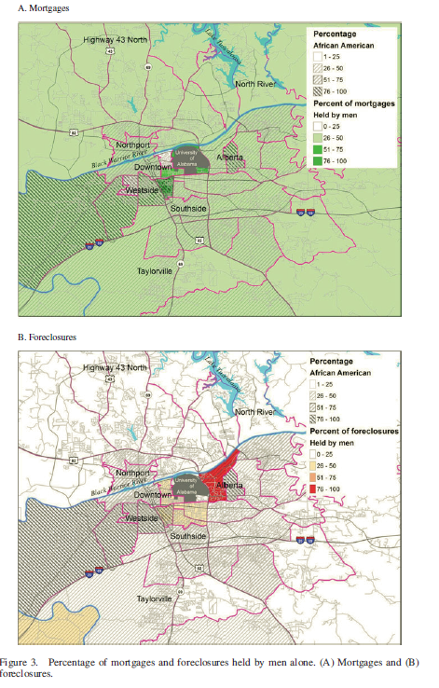
Results
No Statistically significant correlation
No Statistically significant correlation

Slide 24
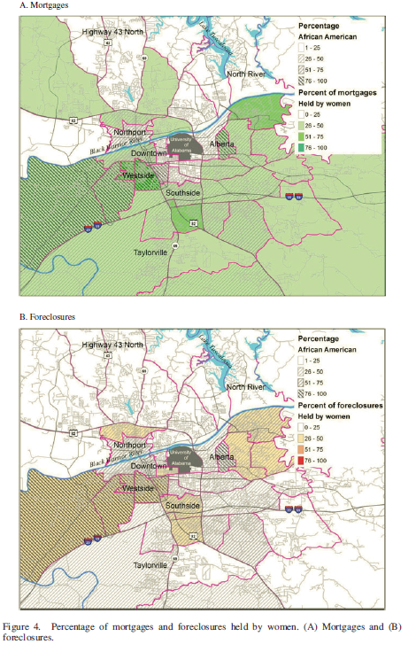
Results:
Statistically significant correlation between location of mortgages and foreclosures belonging to women
Sole women homeowners in majority African-American neighborhoods were most likely to lose their homes to foreclosure.

Slide 25
Discussion – implications of results
Gender impacts in residential mortgages & foreclosures
Documents woman’s vulnerability to housing loss compared to couples and men
Racial impacts in residential mortgages & foreclosures
African-American neighborhoods most affected
Intersection of multiple identities: gender, race, martial status
Intersection of identity and spatial patterns of racial segregation in residential neighborhoods

Slide 26
How do I evaluate whether the authors successfully proved their points?
Do they answer their research question?
Are their data strong and from reliable sources?
Look at discussion of data limitations
Do they over-reach in their conclusions?
Do you interpret their maps in the same way they do?
Couples dominated foreclosures (p.9)
Can’t determine women’s situation in joint homeownership (p. 17)
No direct causation made between single women and predatory lending practices -speculative

